Slide 1




DATA ANALYSIS AND DASHBOARD REPORT
ROAD ACCIDENT

Slide 2

TECHNOLOGY USED

Slide 3
Project Overview
The objective of this project is to analysing data on accidents and detect patterns and valuable information concerning the people harmed. The project will utilize various essential metrics known as key performance indicators (KPIs) to assess the severity and consequences of traffic accidents. These KPIs will include the overall number of casualties based on accident severity, vehicle type, road surface and other relevant factors.
Notes:
When conducting research, it is easy to go to one source: Wikipedia. However, you need to include a variety of sources in your research. Consider the following sources:
Who can I interview to get more information on the topic?
Is the topic current and will it be relevant to my audience?
What articles, blogs, and magazines may have something related to my topic?
Is there a YouTube video on the topic? If so, what is it about?
What images can I find related to the topic?

Slide 4
Business Case
The purpose of this project is to enhance road safety and mitigate the likelihood of accidents by assisting transportation authorities, law enforcement agencies, and other involved parties in enhancing safety and minimizing the number of casualties resulting from accidents through the analysis of accident data and the identification of trends and patterns.

Slide 5
Skills showcased in this project
Data Cleaning, Data Transformation, Data Analysis.
Filtering, Sorting and Conditional function.
Pivot Tables and Pivot Chart.
Data Visualisation and Dashboard creation.

Slide 6

Requirements and KPIs
Created a road accident dashboard for the years 2021 and 2022 so that we can have insight on following aspects -
Primary KPI - Total Casualties and Total Accident values for Current Year .
Primary KPI's-Total Casualties by Accident Severity for Current Year .
Secondary KPIs - Total Casualties concerning vehicle type for the Current Year
Monthly trend showing a comparison of casualties for the Current Year and the Previous Year
Casualties by Road Type for the Current Year
Current Year Casualties by Area/ Location & by Day/Night
Total Casualties and Total Accidents by Location
Notes:
Once you find your sources, you will want to evaluate your sources using the following questions:
Author:
Who is the author?
Why should I believe what he or she has to say on the topic?
Is the author seen as an expert on the topic? How do you know?
Current:
How current is the information in the source?
When was the source published?
Is the information out-of-date?
Accuracy:
Is the content accurate?
Is the information presented objectively? Do they share the pros and cons?

Slide 7
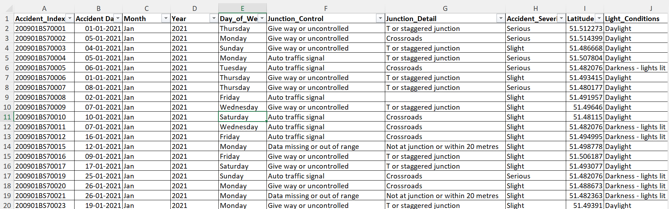
DATASET

Slide 8
Data Cleaning and Transformation
This stage began with getting to know the dataset and checking for any data quality issues.
Checking NULL values, blanks and Errors.
Removing duplicates, and irrelevant columns.
Made sure data is consistent and clean with respect to data type, data format and values used.
Creating 2 new attributes 'Year' and 'Month' were added for logical and easy interpretation of dataset.
Notes:
After consulting a variety of sources, you will need to narrow your topic. For example, the topic of internet safety is huge, but you could narrow that topic to include internet safety in regards to social media apps that teenagers are using heavily. A topic like that is more specific and will be relevant to your peers. Some questions to think about to help you narrow your topic:
What topics of the research interest me the most?
What topics of the research will interest my audience the most?
What topics will the audience find more engaging? Shocking? Inspiring?

Slide 9
Data Analysis
Created a "Data Analysis" sheet to summarize all the pivot table Data for a new user or developer or client to ease their work and gathered information. On this sheet nine pivot tables were created to summarise the data and help identify trends in the dataset focusing on relationship between number of casualties and many factors such as- casualty type, vehicle type, road type, location etc. Monthly trends were also analysed for the years 2021 and 2022.
Notes:
Now, that you have narrowed your topic, you will want to organize your research in a structure that works. There are some common organizational patterns based on the kind of research you are doing.
Organizational Structures:
Cause and Effect- this kind of structure is great for explaining the causes and effects of a topic
Compare and Contrast- in this pattern you highlight the similarities and differences of the topic
Explain process- this structure is great for outlining a series of steps to follow;
Definition- if you want to make sure your audience understands what something is using illustrations, meanings, clarifying misconceptions, you may want to use this structure
Classification- a common organizational structure is grouping like topics or facts from the research together. For instance, in the internet safety about social media apps, you may organize the research where you look at each social media app one at a time

Slide 10
Data Visualization
Finally, the dashboard was created by inserting and customizing the pivot charts of corresponding pivot table. For user friendly and interactive experience slicers and timelines were incorporated. Hyperlinks and connections were also added to necessary icons for seamless navigation.
Notes:
After you’ve done your research, it’s time to put your presentation together. The first step in the process is to introduce the topic. This is a great time to connect your topic to something that your audience can relate. In other words, why should they listen to all the information you will be sharing in your research presentation? What is in it for them? You may also want to include a graphic or image to grab their attention.
Feel free to duplicate this slide by right-clicking on this slide in the slides pane to the left and select Duplicate Slide.
The next step in your presentation is to state your claim or topic clearly. Your teacher may even call this your thesis. As you state your thesis, you may find that this layout is not the best layout for your claim or topic. You can change the layout by clicking the drop-down menu next to the Layout in the Slides menu section. You can choose Two Content, Comparison, or Picture with Caption. Note: A different layout might change the look of the icons on this page.
You will also want to state your facts. You have done the research now share some of the interesting facts with your audience. Facts do not have to be boring; you can communicate facts in a variety of ways by going to the Insert Tab. In the Insert tab you can:
Insert pictures from your computer or online.
Add a chart
Create some SmartArt
Insert a variety of icons to help your facts come to life. Note: You can change the color of the icons by selecting the icon and then click on the Format tab and then Graphics Fill. From there, you will choose a color from the list or choose More Fill Colors to give you more options.
Since this research presentation is a result of your hard work and searching, you want to make sure you support the claims or points in your presentation with facts from your research findings. Make sure you give the author proper credit for helping you share your ideas. If one of your sources has a video that is relevant to your topic, you can add the video as added support. Keep in mind the length of the video and the amount of time you have for your presentation. For a 5 minute speech, the video should be no longer than 30 seconds.
Questions to consider:
How will you state the author of the source?
Will you need to cite the source on the slide?
What are some ways you can engage your audience so they feel like they are a part of the presentation? Some ideas to consider is by taking a quick poll like: by a show of hands, how many of you think school uniforms are a way to cut down on bullying? Another suggestion is to have them hold up a certain number of fingers to see if they agree or disagree. Finally, you can share a story that the audience can relate to that makes them laugh.
After all the applause, your audience may have some questions. Be prepared to answer some of their questions by making a list of questions you think they might ask. You may also want to share the presentation with them by providing the link to your presentation, if they want more information.

Slide 11
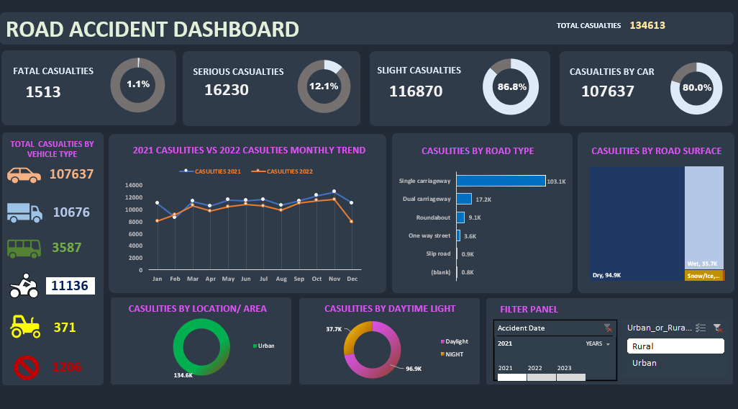
Below is a snippet of the final dashboard in Excel

Slide 12
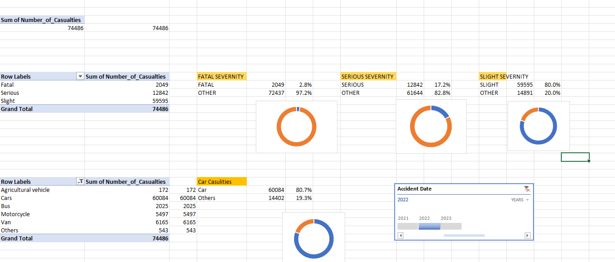

Slide 13
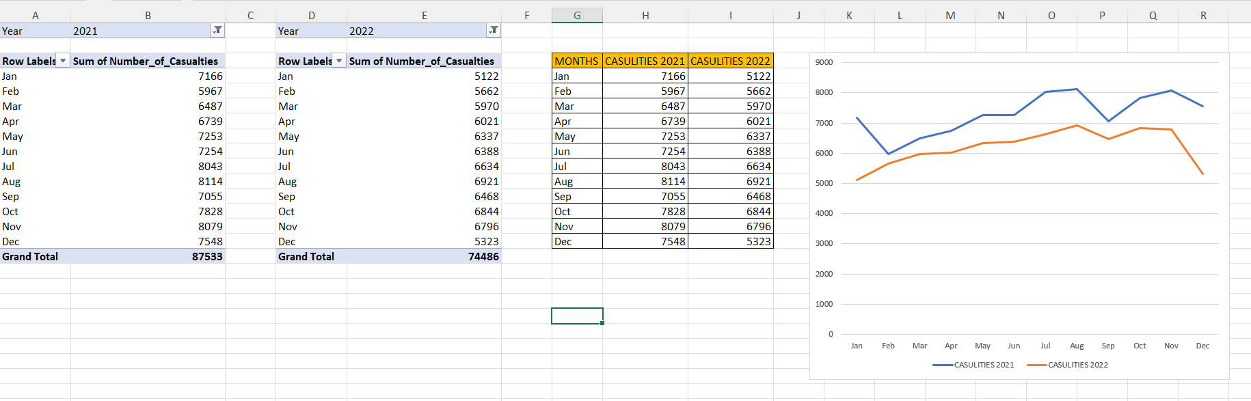

Slide 14
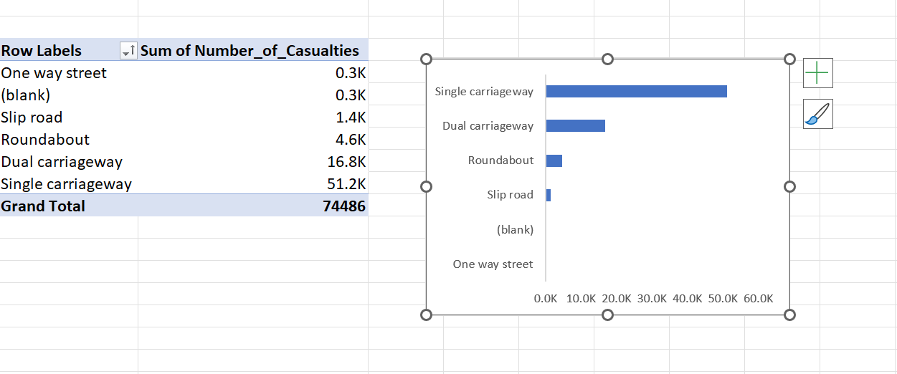

Slide 15
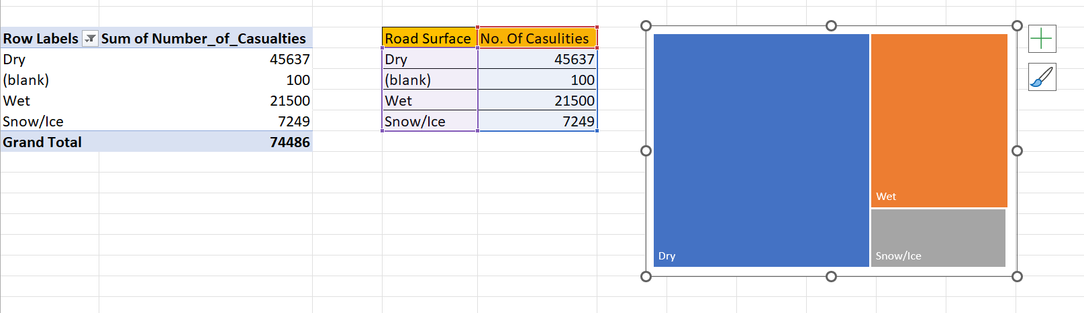

Slide 16
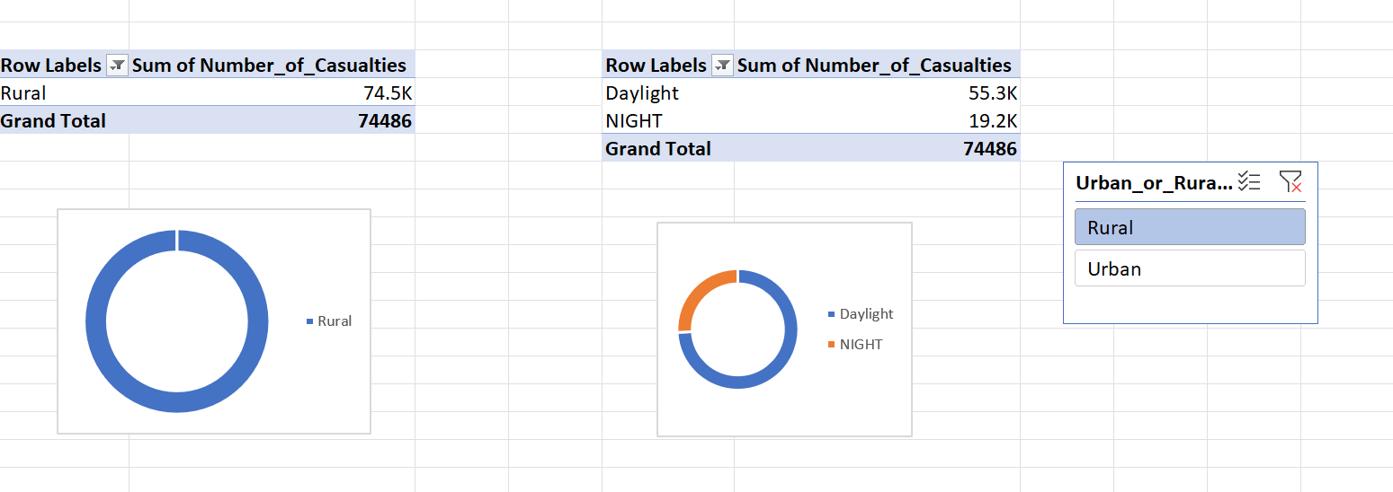

Slide 17
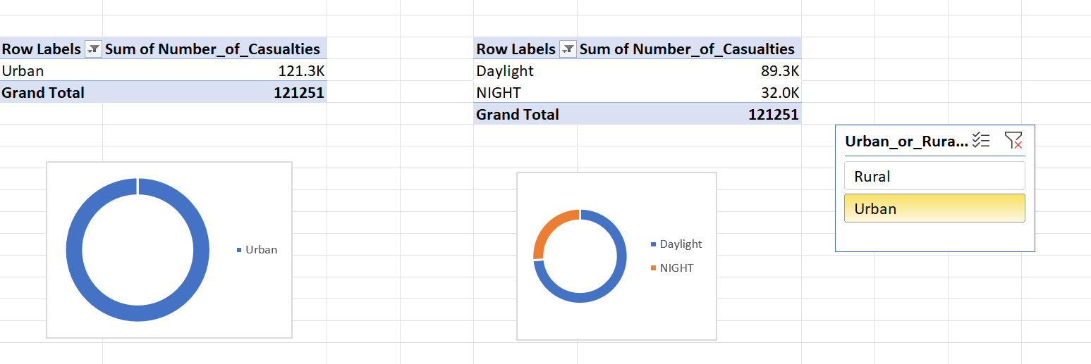

Slide 18
Key Insights
📈 Total Casualties Analysis: The dashboard reveals that a staggering 74,846 casualties occurred after accidents during the two-year period.
📅 Peak Months: Overall the number of casualties were slightly higher in 2021 than 2022. Maximum Casualties happened in the month of October and November in both the Years and minimum casualties take place in the month of February and March.
🚗 Casualties by Vehicle Type: Car accidents accounted for the highest number of casualties, contributing to 80.7% of the total. On the other hand, casualties were minimal in accidents involving other vehicle types.
🩸 Casualties by accident severity: Slight severity form the bulk of casualties 80.0% whereas there are only 20.0% other casualties.

Slide 19
🛣️ Road Type Analysis: Maximum Casualties by Single Carriageway road type (51.2K) and Minimum by Slip road(1.4K)
🌧️ Casualties Distribution by Road Surface: Highest Distribution of total casualties on Dry road surfaces (67%)
🏙️ Casualties Relation by Area/Location: Urban areas form the majority of casualties after an accident (121.3k)
☀️ Casualties Distribution by light condition: 73% of casualties take place in daylight condition.

Slide 20
Recommendations based on the Analysis
By comparing casualty trends between the current and previous years on a monthly basis, the dashboard identifies critical periods of October and November. The road safety measure by the traffic police and other stakeholders must be active and focused during these high-risk periods.
Car drivers form bulk of the casualties so they must be targeted for awareness camps and strict monitoring, periodic check-ups on safe driving.
Extra safety measures should be placed Single Carriageway roads and they must be upgraded to double lane wherever possible.
Understanding casualty distribution based on different road surface conditions helps pinpoint areas where road maintenance and surface improvements are essential.
Urban areas should be targeted for interventions to improve road safety in specific and during daytime.

Slide 21
END
This Road Accident Analytics Dashboard opens the door to data-driven decision-making, enabling stakeholders to implement evidence-based interventions that enhance road safety. It serves as a valuable tool for policymakers, traffic authorities, and safety advocates alike.
Thank you for your interest and time. Feel free to give your valuable suggestions and connect with me on http://www.linkedin.com/in/aasthaguptakesharwani
- Aastha Gupta Kesharwani

Slide 22
Presentation Ends
Have a lovely day
Notes:
You can use this slide as your opening or closing slide. Should you choose to use it as a closing, make sure you review the main points of your presentation. One creative way to do that is by adding animations to the various graphics on a slide. This slide has 4 different graphics, and, when you view the slideshow, you will see that you can click to reveal the next graphic. Similarly, as you review the main topics in your presentation, you may want each point to show up when you are addressing that topic.
Add animation to images and graphics:
Select your image or graphic.
Click on the Animations tab.
Choose from the options. The animation for this slide is “Split”. The drop-down menu in the Animation section gives even more animations you can use.
If you have multiple graphics or images, you will see a number appear next to it that notes the order of the animations.
Note: You will want to choose the animations carefully. You do not want to make your audience dizzy from your presentation.

